Slide 2
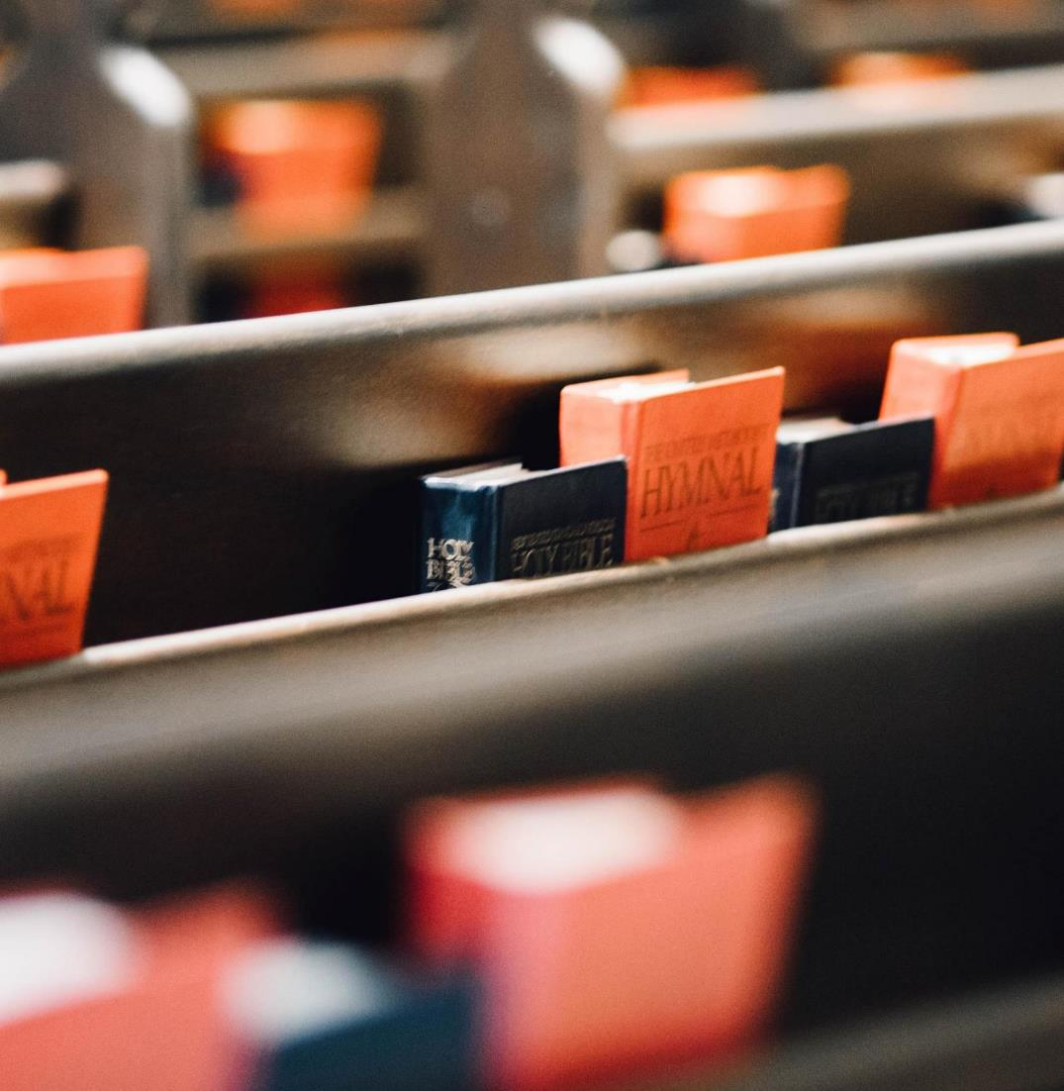
Charge Conference 2023: Gathering
Welcome & Overview
(District Superintendent)
What is a “local church”? “The local church provides the most significant arena through which disciple-making occurs.” BOD ¶ 201
What is “charge conference”? “The charge conference shall be the connecting link between the local church and the general Church and shall have general oversight of the church councils(s).” BOD ¶247.1
What will we do? “The primary responsibilities of the charge conference in the annual meeting shall be to review and evaluate the total mission and ministry of the church, receive reports, and adopt objectives and goals recommended by the church council that are in keeping with the objectives of The United Methodist Church.” BOD ¶247.3

Slide 3
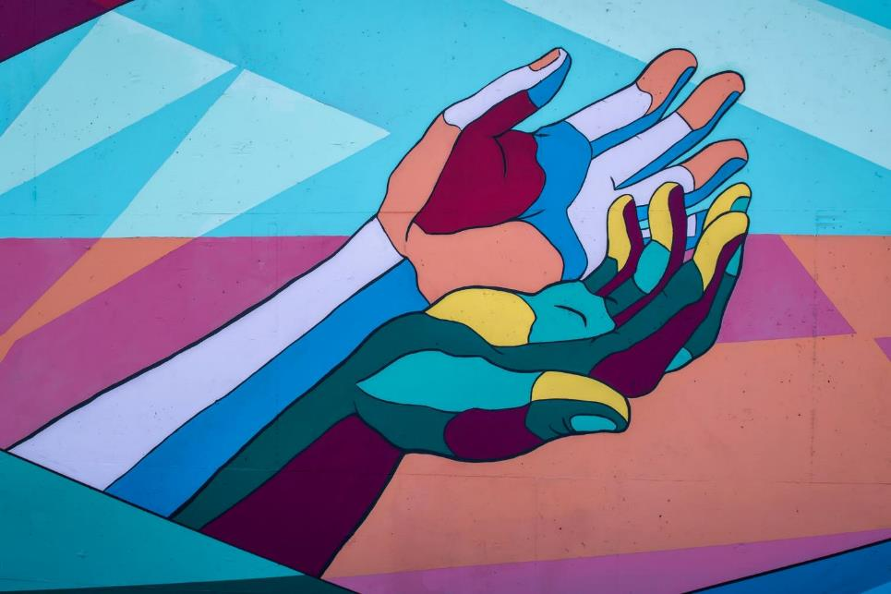
Gathering
Call to Worship (Lay Leader)
In Jesus Christ, there is a new creation.
Everything old has passed away. Everything has become new.
This newness is from God, who has reconciled us through Jesus Christ.
Rejoice and be glad! Everything has become new.
Opening Prayer (Lay Leader)

Slide 4
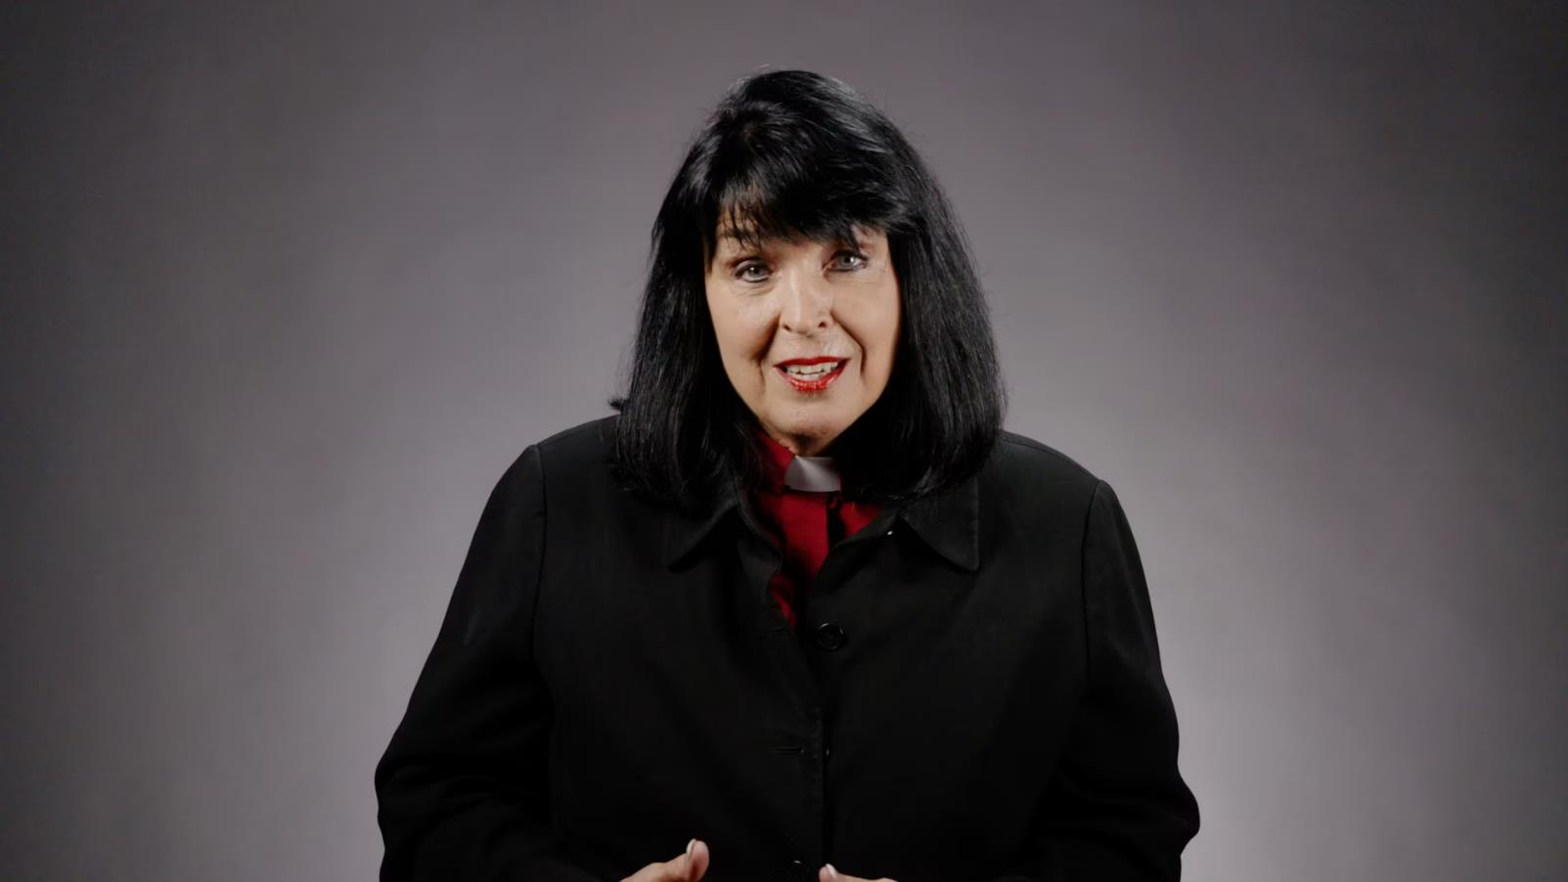
Play Bishop Shelton’s Charge Conference Video

Slide 5
Scripture (Pastor)
Old Testament Lesson: Isaiah 42:1-9 [NRSV]
¹Here is my servant, whom I uphold, my chosen, in whom my soul delights; I have put my spirit upon him; he will bring forth justice to the nations.
²He will not cry out or lift up his voice or make it heard in the street;
³a bruised reed he will not break, and a dimly burning wick he will not quench; he will faithfully bring forth justice.

Slide 6
Scripture (Pastor)
Old Testament Lesson: Isaiah 42:1-9 [NRSV]
⁴He will not grow faint or be crushed until he has established justice in the earth, and the coastlands wait for his teaching.
⁵Thus says God, the Lord, who created the heavens and stretched them out, who spread out the earth and what comes from it, who gives breath to the people upon it and spirit to those who walk in it:
⁶I am the Lord; I have called you in righteousness; I have taken you by the hand and kept you; I have given you as a covenant to the people, a light to the nations,

Slide 7
Scripture (Pastor)
Old Testament Lesson: Isaiah 42:1-9 [NRSV]
⁷to open the eyes that are blind, to bring out the prisoners from the dungeon,from the prison those who sit in darkness.
⁸I am the Lord; that is my name; my glory I give to no other, nor my praise to idols.
⁹See, the former things have come to pass, and new things I now declare; before they spring forth, I tell you of them.

Slide 8
Sermon (District Superintendent)

Slide 9
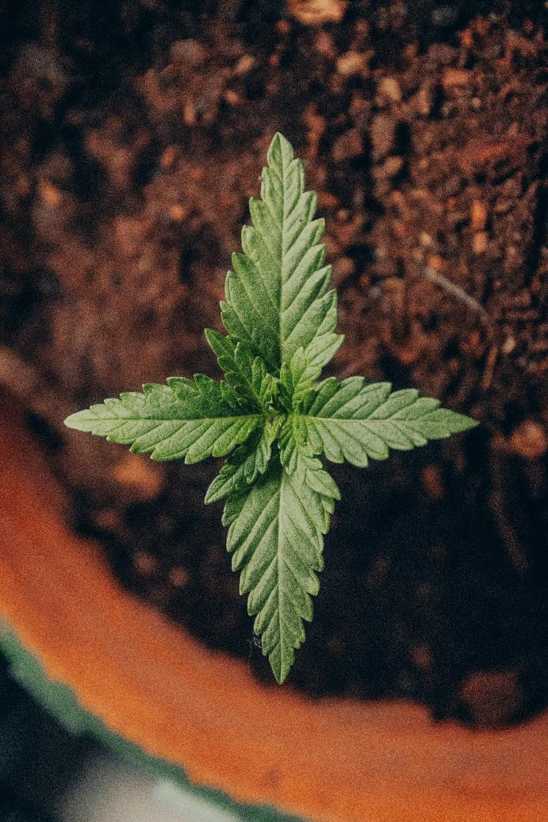
Responding to Our Situation (District Superintendent)
1. What is something you celebrate from the former things you have experienced in the last year?
2. What is something you need to let go from the former things in your life and as a congregation?
3. Is there something new that God is already announcing in your life and congregation?

Slide 10
Our Response (Pastor)
God of steadfast love and mercy, remind us again that in Jesus Christ everything has become new.
For far too often, things seem as they have always been: old habits die hard, difficult situations linger,
failures from our past linger. We look for your promised newness but cannot see it.
Speak to us again of your new creation. Open our eyes to its presence in our lives. Call us forth to claim this newness, that we may be healed and made whole. Amen.

Slide 11
Prayer of Thanksgiving (District Superintendent)

Slide 12
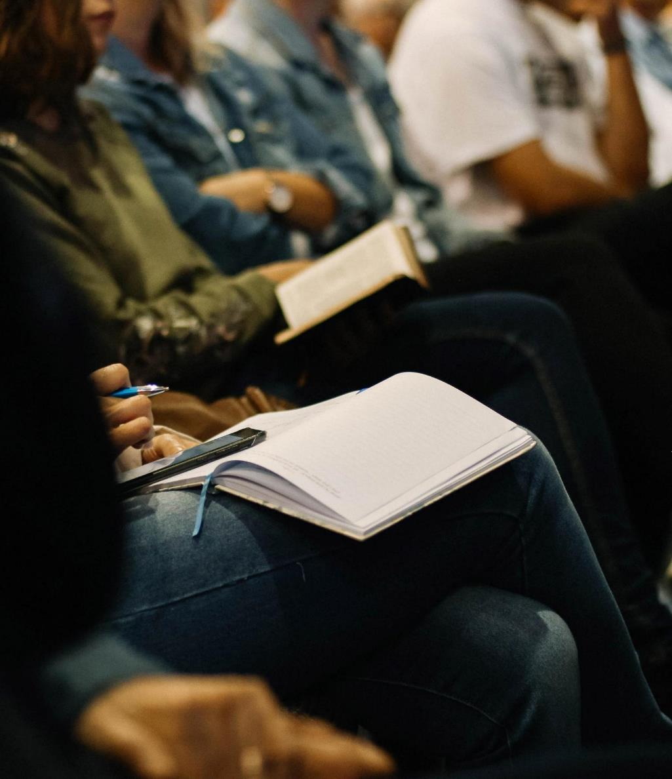
Charge Conference Business
(District Superintendent)
Leadership Report Vote
Compensation Package Vote

Slide 13
Unison Closing Prayer (Pastor)
Let us covenant together as we pray “A Covenant Prayer in the Wesleyan Tradition”:
I am no longer my own, but thine.
Put me to what thou wilt, rank me with whom thou wilt.
Put me to doing, put me to suffering.
Let me be employed by thee or laid aside for thee,
Exalted for thee or brought low for thee.
Let me be full, let me be empty.
Let me have all things, let me have nothing.
I freely and heartily yield all things to thy pleasure and disposal.
And now, O Glorious and blessed God,
Father, Son, and Holy Spirit,
Thou art mine, and I am thine. So be it.
And the covenant which I have made on earth,
Let it be ratified in heaven. Amen.
Benediction (District Superintendent)

Slide 14
Charge Conference 2023

