Slide 1
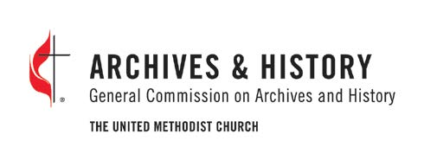
Pride, Shame, & Pain:
methodism’s history with racism and efforts to dismantle it
Heritage Sunday 2021
Logo borrowed from the General Commission on Religion and Race. Kelly Fitzgerald, ed. Racism: The Church’s
Unfinished Agenda, a Journal of the National Convocation on Racism (General Commission on Religion and Race, 1987).

Slide 2
Introduction
Frequently when we think of Black Methodist sheroes and heroes in the fight against racism within and beyond United Methodism the focus is almost always on famous national figures. Yet many of these equality battles were in smaller spaces by less known, but no less important, Black Methodists within the church. Many of these voices had major impacts on the march towards equality throughout creation. There were instances where either family members or married spouses made their life’s work identifying, naming, revaluing, and pushing for inclusiveness as both members of God’s kingdom and within societal structures.
In the following pages is a small sample of these “couples” brought to light once more from the haze of United Methodist history. The first couple is from South Carolina who used their talents and careers to bring justice and illumination through conviction and action. The second couple is a father and son who both became bishops and fought racism in the church. The third and fourth couples were spouses that rose to the pinnacle of church leadership from humble beginnings. The one thread that ties many of these biographies is the role of United Methodism’s historic Black colleges played in shaping their lives. Let us briefly retell their stories which help move United Methodism to a more inclusive body to end racism.

Slide 3
Jacob and Lizelia Moorer
Jacob Moorer, Esq. Moore standing outside Trinity Methodist Episcopal Church
http://catalog.gcah.org/omeka/files/original/72c4ca26e232b68f5eb7ce8283b98002.jpg
Notes:
Jacob Moorer (April 1863-February 27, 1935).
Jacob Moorer, lawyer and civil rights activist, was born in April 1863 to sharecroppers in Orangeburg, South Carolina.
He was educated at Claflin University and graduated in 1892 and was admitted to the bar in 1896. Jacob Moorer was one of the first Black lawyers admitted to the Orangeburg bar early in his career. Before becoming a lawyer he became the principal of LaGrange Academy in Georgia.
Moorer was an active member and leader of the Trinity Methodist Episcopal Church in Orangeburg.
He married Black activist poet, Lizelia Augusta Jenkins Moorer in 1899.

Slide 4
Jacob and Lizelia Moorer
Image from blackthen.com (https://blackthen.com/first-legal-case-of-naacp-pink-franklin-trial/)
Notes:
Politically, he joined the Union Republican Party from which he ran for various state offices and attended a number of Republican conventions.
He fought several cases against disenfranchised election statutes listed in the 1895 South Carolina Constitution. In 1906, Moorer appeared before the Congressional House Committee of Elections over a disputed state election in South Carolina. All this took place while working as a criminal defense lawyer representing Black clients. It’s the latter work where he eventually partnered with John Adams, Sr. that would take them back to Washington D. C. one more time.
Moorer and Adams served as the defense team in the Pink Franklin case before the U.S. Supreme Court. It was only the second time Black lawyers argued before the court and the first Supreme Court case supported by the NAACP.
Moorer would die on February 27, 1935.

Slide 5
Jacob and Lizelia Moorer
Lizelia Augusta Jenkins Moorer
https://www.flickr.com/photos/147039490@N04/39720363814
https://quod.lib.umich.edu/a/amverse/BAR7158.0001.001?view=toc
Notes:
Lizelia Augusta Jenkins Moorer (September 1868–May 24, 1936)
Jenkins Moorer was a famous civil rights poet and teacher.
She was born September 1868 in Pickens, South Carolina. Later she would become a teacher in area primary schools as well as Claflin University.
Lizelia married Jacob Moorer in 1899. Together they would face and fight racism and sexism in both the secular and church worlds.
During the 1924 General Conference, she argued for women’s ordination in the Methodist Episcopal Church. The conference agreed and voted to give women the right of ordination as local deacons and elders.
It is not an understatement to say she was the most famous Black Methodist women activist poet of all-time. Her book, Prejudice Unveiled: and Other Poems, was published in 1907.
https://quod.lib.umich.edu/a/amverse/BAR7158.0001.001?view=toc

Slide 6
Jacob and Lizelia Moorer
The Southern Pulpit
The Southern pulpit, in our eyes, Descends to make a compromise With evil things in heaven’s name; The kind that brings a blush of shame.
The evils to the Negro shown, His rights that Southern men disown, We view with sorrow and distress, Its lack of effort to suppress.
Prevailing thought it cannot cross, If so, it feels financial loss;
The gold to it is dearer far, Than all the rights of Negroes are. It preached that slavery was right, Upon the Scripture based its fight, Why should we now expect a change So radical? Such would be strange. This pulpit fails to higher climb Than sentiment at any time. Such grades of preaching cannot live, The truth alone can freedom give.
Lizelia Jenkins Moorer wanted to tell the story of slavery and its aftermath in raw context. She said, “Seeing that the one cannot get at the facts, while the other will not, I reach the conclusion that the story must be told by a Negro-one who is a victim to the inconvenience of prejudice.”
All her poems can be read at https://www.poeticous.com/lizelia-augusta-jenkins-moorer
Notes:
Lizelia Jenkins Moorer wanted to tell the story of slavery and its aftermath in raw context. She said, “Seeing that the one cannot get at the facts, while the other will not, I reach the conclusion that the story must be told by a Negro-one who is a victim to the inconvenience of prejudice.”
All her poems can be read at https://www.poeticous.com/lizelia-augusta-jenkins-moorer

Slide 7
Bishops Matthew Clair, Sr. and Jr.
Notes:
Matthew Wesley Clair - October 21, 1865 - June 28, 1943
Matthew Wesley Clair was born in Union, West Virginia, in 1865 and at 15 years old licensed to preach in the Simpson Methodist Episcopal Church located in Charleston.
In 1889, he graduated from Morgan College in Baltimore, Maryland. Later he would receive honorary degrees from Morgan, Howard, and Wilberforce Universities.
Clair was married twice. He first married Fannie Walker on November 12, 1889. The marriage produced five sons which included future Bishop Matthew Walker Clair, Jr. After Fannie’s death, he married Eva F. Wilson on November 2, 1926.
Upon graduation, the segregated Washington Annual Conference admitted Clair as a probationary clergy member. The 1893 annual conference ordains Clair in full connection with all the rights and privileges of a minister in the church.
His church appointments ranged from West Virginia, Virginia, and Washington D.C. Perhaps his most famous appointment was to the historic Asbury Methodist Episcopal Church in the nation’s capital. Under his leadership a new, larger church with a 1,800-seat sanctuary to replace the old church to meet ongoing congregational needs. Clair also served as district superintendent and editor of the conference newspaper.
Matthew Clair was no stranger to General Conference. He served as a delegate three times between 1906 to 1920. It was the 1920 General Conference that elected him bishop to the Monrovia, Liberia area. Clair holds the distinction of being one of the first two Black bishops in the denomination.

Slide 8
Bishops Matthew Clair, Sr. and Jr.
Francis Asbury Statue Dedication Washington, D.C. – 1924
https://www.loc.gov/resource/npcc.26317/
Ministerial Training School, Covington Area
Philander Smith College, August 1, 1935
Notes:
While serving in Liberia his talents did not go unnoticed. The Liberian president appointed him to the national board of education as well as other national boards. Bishop Clair spent a total of eight years in Liberia before assuming episcopal oversight of the Lexington Annual Conference. He led the annual conference for eight years before retiring.
Clair served on several boards in various capacities which include the American Geographic Society, Federal Council of Churches, Morgan, and Philander Smith Colleges.
In 1924, Clair returned to Washington D.C. for one more tribute to his ministerial career. President Calvin Coolidge invited the Bishop to give the public prayer at the dedication of the Frances Asbury statue.
One of his famous quotes couples the role and work of the church to help forge equality in American society. He said, “The Negro has survived mainly because of his spiritual nature. Religion is the greatest help in his upward struggle. He turns to the church as the plant to the sun.”
Bishop Clair died on June 28, 1943.

Slide 9
Bishops Matthew Clair, Sr. and Jr.
Bishop Matthew Walker Clair, Jr.
Bishop Matthew and Ethel Clair
Beginning Their World Travel - 1952
Notes:
Matthew Walker Clair, Jr. - August 12, 1890 – July 10, 1968.
Matthew Walker Clair, Jr., son of Bishop Matthew Wesley and Fannie Walker Clair, is the second half of the first father/son clergy combination to become non-missionary bishops on the Methodist side of United Methodism. He was born August 12, 1890, in Harper’s Ferry, West Virginia.
Education played an important role in his formative years. He attended Syracuse, Howard, and Boston Universities. As a side note both Syracuse and Boston were started by the Methodist Episcopal Church.
The segregated Washington Annual Conference ordained Clair in 1917. Shortly thereafter he became a chaplain in the 320th Labor Battalion, United States Army. During World War I the battalion saw action in France.
On November 25, 1920, he married Ethel Christian Smith. Between them, they had two daughters.
Clair would pastor churches in Virginia, West Virginia, Florida, Colorado, and Illinois. He also worked at the Board of Home Missions in 1929. Afterward, he became Professor of Practical Theology at Gammon Theological Seminary, 1936-1940.
In 1952, the segregated Central Jurisdiction elected Clair to the episcopacy. The Council of Bishops sent him to appraise various ministries and/or represent the Council around the world. His travels took him to Africa, Southeast Asia, Europe, Central America, and South America. Starting in 1956, he would serve as the presiding bishop for the Central Jurisdiction’s St. Louis Episcopal area.

Slide 10
Bishops Matthew Clair, Sr. and Jr.
Bishop Clair Meeting with Central Jurisdiction Leaders
Notes:
Like his father, Clair displayed important leadership skills that manifest themselves among a variety of organizations both within the church and beyond. Bishop Clair would serve on several church general agencies and boards which include the following; Board of Education, Christian Social Concerns, Promotion and Cultivation, Church Union, Ecumenical Consultation, Study Faith and War in the Nuclear Age. Clair’s voice on these boards provided opportunities to represent Black Methodist positions in their decision-making processes.
Other leadership positions include serving as president of Philander Smith’s Board of Trustees and the National Council of Churches. The Central Jurisdiction’s College of Bishops elected Clair to be president from 1960 to 1962.
Matthew Walker Clair, Jr. retired from active ministry in 1964 at the same time General Conference was beginning to dismantle the racially motivated Central Jurisdiction. He died on July 10, 1968, which ironically, is the same year the newly organized United Methodist Church General Conference abolished the Central Jurisdiction.

Slide 11
Charles and Marie Copher
Reverend Charles and Marie Copher. Image taken while serving Fourth Methodist Church in Boston, Massachusetts, circa 1945
Dr. Copher is the second Black Methodist to serve on the UMC Judicial Council from 1968 to 1984
Notes:
Charles Buchanan Copher March 3, 1913 - August 15, 2003
Charles Buchanan Copher (1913-2003), United Methodist minister and Hebrew Bible/Old Testament scholar was born to Tabitha Shelton and Henry L. Copher of Troy, Missouri, on March 3, 1913. At an
early age, Copher displayed a remarkable intellect which became self-evident when named Valedictorian of his elementary school graduation class. Four years later he would graduate from Summer High School as Salutatorian.
Charles married Marie on May 24, 1939. They would be together for sixty-four years until his death in 2003.
Copher's abiding love of learning continued at Stowe Teachers College in St. Louis, Missouri. After his first year, he transferred to Clark College, Atlanta, where he graduated with a B. A. degree in
1938. During this time in his life there came a call to the ministry. This, in turn, led Copher to enroll in Gammon Theological Seminary culminating with a Bachelor of Divinity degree in 1939. After graduating from Gammon he earned a theological degree from Oberlin Graduate School of Theology. Copher went on to earn a Ph.D. in Biblical Literature and Languages at the Boston University Graduate School in 1947. He continued doing additional graduate-level work in post-doctorate programs at New York University and University of Chicago Divinity School.
History primarily remembers Charles Copher as a cutting-edge scholar but he was also a successful pastor. Most of his appointments to local churches happened during his graduate school years. When
attending Oberlin, the bishop appointed him to the Rust Methodist Church in 1939. Two years later Copher changed pulpits as pastor of the Eleventh Street (now Asbury) Methodist Church in Columbus,
Ohio. The following year Copher moved to Boston where he became the pastor of Fourth Methodist Church (now Union) until 1948.
His ministry included work within the larger structure of United Methodism. The high point of this work came as the second Black Methodist to serve as a Judicial Council member from 1968 to 1984. The
council is the denomination's highest court. The Council is also known as United Methodism’s Supreme Court which is an appropriate comparison.

Slide 12
Charles and Marie Copher
The image shows the impact and affection both Cophers’ had on the ITC faculty and students
Reverend Dr. Charles Copher in Retirement
Notes:
Copher left the pastorate to begin an illustrative academic teaching career at his alma mater, Gammon Theological Seminary. The seminary would later become part of the Interdenominational Theological Center (ITC) consortium. During his tenure at Gammon, Copher also taught at Clark College as a visiting instructor (1948-1953). Copher's skills as a respected educator and beloved
by his students allowed him to rise to the rank of a full professor for Biblical Studies and Languages (1958-1978). ITC recognized his administrative talents through his positions as Dean of
Instruction (1959-1972) and Vice President of Academic Affairs (1972-1978). Copher retired from ITC in 1978. ITC honored his life work by creating the Charles B. Copher Annual Faculty Lectures.
Copher's cutting-edge study on Black presence in the Bible drew from a plethora of scholarly sources as well as applying literary-critical and contextual studies to Ancient sacred texts. The study quickly became Copher's signature contribution to the field and would transform Biblical and Theological studies. The fruit of his research appeared in various print mediums such as religious journals, encyclopedia articles, and books. United Methodist-focused writings appeared in serials such as the Central Christian Advocate, devotional literature, and Sunday School materials. The topic also made him an in-demand speaker ranging from national gatherings such as Black Methodist for Church Renewal to seminars in
local churches.
Perhaps his most enduring legacy resides in the warm memories of his former students. This illustrates how he did more than just teach the Bible but also had a profound effect on their chosen career paths within the church.
Charles Buchanan Copher died on August 15, 2003. Copher’s funeral was held at the First United Methodist Church, Hyattsville, Maryland. He is buried in Harmony Memorial Park, Landover,
Maryland.

Slide 13
Charles and Marie Copher
Marie W. Copher
Notes:
Marie W. Copher July 28, 1914 - May 16, 2012
Marie W. Copher (1914-2012), United Methodist Lay Women, was born in Franklin, Georgia, on July 28, 1914, to Johnnie W. and Grace V. White. After graduating high school Copher went on to earn
degrees from Clark College (B.A., 1952), Boston University's School of Education (Ed.M., 1953), and the University of Michigan (M.S.W., 1969). Her career in social work primarily focused on the welfare of
families, especially those of children, women, and college students.
Early in Copher's career, she became a woman's counselor at Clark College. From there she moved on to Spelman College to accept the position of Assistant Dean of Women. After leaving Spelman, Copher began working in various offices dealing with adoption and foster care in the State of Georgia's various social service departments. She started working in the Fulton County Department of Family and Child Services and ended her career as the Supervisor of State Adoption Service and Interstate Compact on Placement of Children. Copher retired in 1982.
Another aspect of her professional life includes writing articles on family social work and adoptions. Copher served in various leadership positions within the profession on various organizations
and panels. Examples would include adoption panels, develop curriculum to train staff who work on special need's adoptions and a member of a Steering Committee of Region IV Adoption Resource Center. Copher's other passion was active leadership participation within the United Methodist Church.

Slide 14
Charles and Marie Copher
Marie Copher
Boston, Massachusetts, 1946
Marie and Charles Copher
Unknown Location and Date
Notes:
Marie was a delegate to various General, Jurisdictional, and Annual conferences. Other denominational positions include serving as a director for the Board of Missions and elected membership in both the General Board of Pensions and General Commission on Archives and History (GCAH). Copher also served as president for United Methodist Women (UMW) as well as chairperson for North Georgia
Annual Conference UMW. On the local level, Copher served in leadership positions for both the Ariel Bowen UMC and Murphy Harpst Family Children Services. Ecumenical work included being a delegate
to a World Methodist Conference meeting and the World Federation of Methodist Women. Church Women United, an ecumenical group that included many United Methodist members, would also elect
her to the office of President.
United Methodist history became another passion for her as evident in serving on GCAH, North Georgia Annual Conference CAH, and local church boards. Perhaps her crowning event in this area was the collecting, writing, and publication of "The Journey, United Methodist Women in North Georgia, 1878-1983." True to her leadership style Copher unselfishly gave credit to all who collaborated on the project amongst her North Georgia UMW peers.
Marie married Charles on May 24, 1939. They would be together for sixty-four years until his death in 2003. Death overtook Marie Copher on May 16, 2012, in Mitchellville, Maryland. She is buried next to her husband at the Harmony Memorial Park, Landover, Maryland.

Slide 15
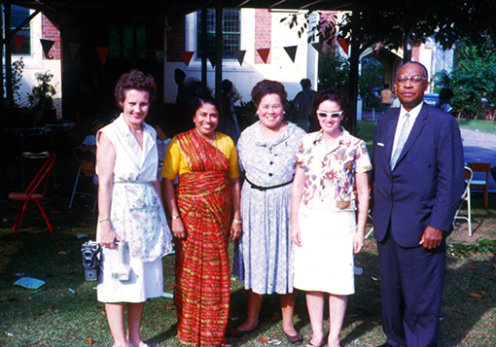
Bishop Noah and Carolyn Moore
Bishop and Mrs. Moore in Retirement,
Atlantic City, NJ - 1972
Bishop and Carolyn Moore With Missionaries
Singapore - 1963
Notes:
Bishop Noah Watson Moore, Jr. (March 28, 1902-May 14, 1996)
Bishop Noah Moore, son of Delaware Annual Conference pastor and district superintendent would faithfully serve the church his entire life by fighting for inclusion, civil rights, and economic parity.
Like his father before him, Moore graduated from Morgan College, one of the MEC Freedmen’s Aid Society schools, where he would later serve as a trustee and vice-president of its corporation. Afterward, he would graduate from Drew Theological School. The 1932 Delaware Annual Conference ordained him into full connection.
On November 27, 1926, he married Carolyn W. Lee. Between the two they would become a force for social and racial change while pushing Black presence in leadership positions throughout the denomination.

Slide 16
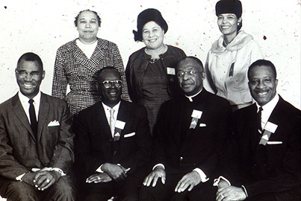
Bishop Noah and Carolyn Moore
Bishops Noah Moore and Edgar Love at the 1963 March on Washington
World Methodist Council, Oslo, Norway – 1961
Bishop and Carolyn Moore with Other Delegates
Notes:
Moore served as pastor and district superintendent to Black Methodist churches in New York State, Maryland, and Pennsylvania. His most well-known appointments were all In Philadelphia. They were Camphor, historic Zoar, and Tindley Temple. While ministering in Philadelphia, he served on various boards and organizations. These include the Christian Street Y.M.C.A., Philadelphia Housing Authority, Urban League, N.A.A.C.P., and the Health and Welfare Agency in South Philadelphia. His leadership on these boards help to fight racism, provide housing for the poor, and address economic inequalities for Black Philadelphians.
The 1960 Central Jurisdiction elected Moore to the episcopacy and assigned him to the New Orleans area which included Louisiana, Texas, and West Texas annual conferences. He continued his fight for civil rights and the plight of poverty.
The Bishop served on denominational and ecumenical boards which included the Council on World Service and Finance, World Methodist Council, and General Board of Education. Moore served as a trustee to several of our Historic Black Colleges and Universities: Dillard, Gammon Theological Seminary, Huston-Tillison, Morristown, and Wiley College.

Slide 17
Bishop Noah and Carolyn Moore
Bishop Moore Greeting Parishioners
Nairobi, Kenya - 1967
Bishop Moore Visiting a Leprosy Hospital and Clinic
Ganta, Liberia - 1967
Notes:
Bishop Moore was one of three Central Jurisdiction representatives on The Commission on Interjurisdictional Relations which created the plan to end the Central Jurisdiction by the 1968 merger with the Evangelical United Brethren Church.
After the 1968 merger, Moore became the presiding bishop over the predominately white Nebraska Annual Conference until his retirement in 1972.
Bishop Noah Moore died of cancer in Atlantic City, New Jersey, on May 14, 1996.

Slide 18
Bishop Noah and Carolyn Moore
Carolyn Moore with Central Jurisdiction Spouses - 1967
Carolyn Moore Visiting Orphanage
Mutari, Zimbabwe - 1964
Notes:
Carolyn W. Lee Moore (December 14, 1904-September 1, 1985
Carolyn W. Lee was born in Philadelphia, Pennsylvania, on December 14, 1904.
Carolyn spent most of her young life in Atlantic City, New Jersey, until 1919 when she enrolled at Princess Anne Academy, a historic Black Methodist women’s secondary school affiliated with Morgan College. It was during this time she met her future husband. It is worth noting that her school was acquired by the University of Maryland in 1935 as an act of racial segregation to keep Black women students away from the main campus. This would continue until 1954 (https://www.umes.edu/125/Content/Stories/From-Academy-to-College/). Later she would attend Temple University.
On November 27, 1926, she married Noah Watson Moore, Jr. in Washington, D.C., and between the two of them would become a force for social equality and racial change.
During World War II she worked with the American Red Cross to help overseas soldiers and sailors’ families cope with pressures brought on by the conflict.

Slide 19
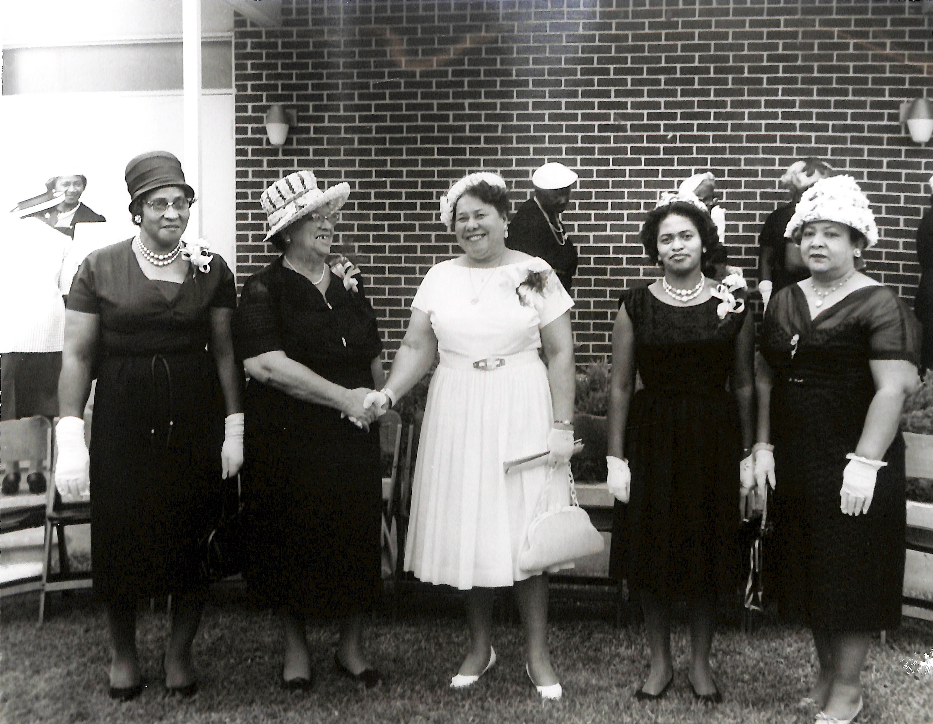
Bishop Noah and Carolyn Moore
National Association of Ministers Wives 19th Annual Conference Meeting Pittsburgh, Pennsylvania 1959
Carolyn Moore attending a
National Association of Minister’s Wives and Widows Meeting
Notes:
Volunteering was a way of life. She participated in many organizations on special projects. Carolyn was also a member of The National Council of Negro Women.
When her husband became bishop for the Nebraska Episcopal area, Carolyn, with a bell in hand, volunteered to work with the Salvation Army’s annual Christmas collection on various street corners.
Perhaps she is best remembered for her work and leadership with the National Association of Minister’s Wives and Minister’s Widows. The NAMWMW membership was primarily Black women who found support, mentoring, and life-long friendships which help to empower clergy spouses in ministry and parsonage expectations but also dealing with racism and sexism within the church.
The spirit in which she nurtured and guided NAMWMW members also extended to Methodist clergy spouses and lay leaders in Bishop Moore’s various appointments. This was especially true when he became a bishop.
Carolyn Moore died in Atlantic City on September 1, 1985.

Slide 20
Isaiah 11:6 – And the Children Shall Lead Them
The Isaiah passage is a powerful vision of how transformative the Kingdom of God is in the life of the church and beyond. The prophet was not foretelling but forth-telling God’s plan for Israel, and by extension the church, on how redeemed communities and individuals live into the divine mandate. Who better to teach us than small children with anti-racist tendency who are not born racist but taught to be so by family, disinformation, and even the church?
The Bear Tavern Elementary 5th grade class in Titusville, NJ, teaches us what a moment of anti-racism looks like with their act of kindness to United Methodist civil rights and LGBTQ inclusion leaders Reverend Gilbert and Grace Caldwell. Let these Isaiah 11:6 infused children’s heart-felt example lead each of us to be inclusive, loving, and reconciling as a means of grace to end racism, full inclusion, and live into the Kingdom of God here on earth.

Slide 21
Sources and Acknowledgements
Most of the images and content are from our online Digital Galleries (http://catalog.gcah.org/omeka/), annual conference obituaries, Encyclopedia of World Methodism, or personal papers deposited in the GCAH archives. We invite you to visit our repository to use the archives, Methodist library, and the African American Heritage Center (AAMHC) collections for all your research needs. Contact Frances Lyons, our Reference Archivist, at research@gcah.org for more information.
Here are links to finding aids used in this presentation:
Matthew Clair Jr.: http://catalog.gcah.org/publicdata/gcah569.htm Charles and Marie Copher: http://catalog.gcah.org/publicdata/gcah5708.htm
Bishop Noah Moore papers are almost done for public use. Please contact research@gcah.org for access.
All other images and resources outside GCAH are linked to their appropriate websites. Thank all of you for letting us use your online archival records! We encourage you to visit these sites for more United Methodist-related information.
There are many individuals to thank for their input. Special thanks to my wonderful colleagues at GCAH.
Mark Shenise, Associate Archivist

