Slide 1
Introduction to Lay Servant Ministries
THE BASIC COURSE

Slide 2
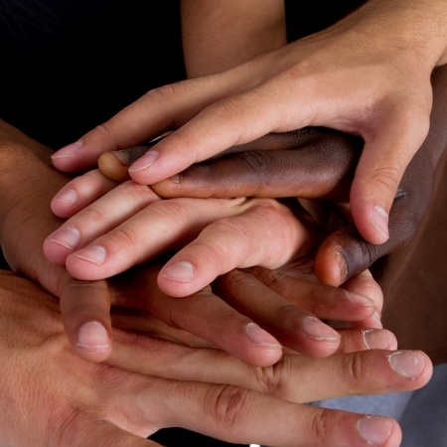
Introductions

Slide 3
WORSHIP
Notes:
Read Scripture: I Peter 2:9-10
Sing: “We Are Marching” (TFWS #2235b)

Slide 4
Ministry for All
Who is a “minister”?
Pastors practice the ministry of identity.
Their work is among believers as internists in Christ’s body. They are called to teach me about my potential in Christ. I need this ministry to prevent amnesia—
That disease of the mind that causes me to forget
who I am as a Christian.
I am a minister, too!
(Pete Hammond, Lessons, Prayers & Scriptures on the Faith Journey, Intervarsity/USA Marketplace, 72.)

Slide 5
(Ministry for All)
I practice the ministry of vitality.
My work is in the world, as a farmer, a soldier, an ambassador,
I am called to be salt, light, and leaven in a sick and
broken world—
Monday through Saturday.
The world needs this ministry to protect it from anemia—
that disease of the blood that slowly robs the system of its health.
All Christians are in ministry!
(Pete Hammond, Lessons, Prayers & Scriptures on the Faith Journey, Intervarsity/USA Marketplace, 72.)

Slide 6
Prayer
I have heard your call to priesthood, my Lord.
I have heard your call to be in mission and ministry.
Thank you for calling me out of darkness into your marvelous light.
May I declare your praises in all that I am and in all that I do! Amen.

Slide 7
SESSION 1: Learning Outcome Goals
Be able to
1. describe the reality of the priesthood of all believers and God’s call on our lives
2. discuss spiritual gifts, their meaning and purpose
3. describe the need for a response to God’s call
4. discuss the early Methodist movement and the role of laity

Slide 8
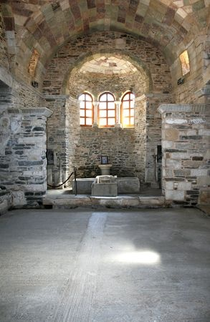
MINISTRY OF THE BAPTIZED
Notes:
8
Read from Book of Discipline pg. 94, paragraph 126, “Ministry of All Christians.“ “All Christians are called through their baptism to this ministry of servanthood in the world to the glory of God and for human fulfillment.”

Slide 9
The Call to Ministry
¶220. – The Call to Ministry of All the Baptized – All members of Christ’s universal church are called to share in the ministry which is committed to the whole church of Jesus Christ. Therefore, each member of the United Methodist Church is to be a servant of Christ on mission in the local and worldwide community. This servanthood is performed in family life, daily work, recreation and social activities, responsible citizenship, the stewardship of property and accumulated resources, the issues of corporate life and all attitudes towards other persons.
(The Book of Discipline – United Methodist Church, 2012)

Slide 10
(The Call to Ministry)
Participation in disciplined groups such as covenant discipleship groups or class meetings is an expected part of personal mission involvement. Each member is called upon to be a witness for Christ in the world, a light and leaven in society and a reconciler in a culture of conflict. Each member is to identify with the agony and suffering of the world and to radiate and exemplify the Christ of hope.

Slide 11
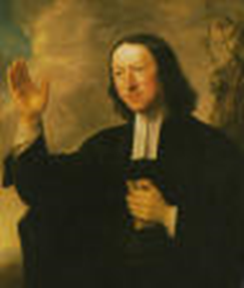
Wesleyan Emphases
Understanding of God’s Grace - Prevenient
- Justifying
- Sanctifying
Faith Evidenced by Works of Piety and Mercy
-Scriptural Holiness
-Social Holiness

Slide 12
A Connectional Church
Mutual responsiveness to one another and the world
Accountability to God and one another at all levels of the church
Shared mission and ministry through our apportionments and appointment system
Prayerful concern for one another as we watch over one another with love

Slide 13
Priesthood of Believers
“But you are a chosen race, a royal priesthood, a holy nation, a people who are God’s own possession. You have become this people so that you may speak of the wonderful acts of the one who called you out of darkness into his amazing light. Once you weren’t a people, but now you are God’s people. Once you hadn’t received mercy, but now you have received mercy.”—I Peter 2:9-10 (CEB)
Notes:
13
That’s you and that’s me – not just clergy, but laity and clergy called to being the light of Christ to others
We are to express evangelical faith in evangelical living. I quote from Wesley’s Gen. Rules and the Book of Discipline the expectations as people of faith. ”It is therefore expected of all who continue therein that they should continue to evidence their desire of salvation. First by doing no harm, by avoiding evil of every kind. Secondly: by doing good of every possible sort, and, as far as possible, to all men [people]. Thirdly: by attending upon all the ordinances of God.
To Wesley Discipline was not church law; it was a way of discipleship.

Slide 14
Called by GOD
To Love
and Serve
Notes:
14
Read - Paragraph 126 of Book of Discipline - “This means that all Christians are called to minister wherever Christ would have them serve and witness in deeds and words that heal and free." The ministry of the laity is an option for those who have heard God’s call, It is a frontline ministry because lay persons have direct access to the community and the real world thru their secular jobs and activities.
The call to ministry is both a privilege and an obligation. We are privileged to be in relationship with God and to be a part of Holy nation, a royal priesthood, one of God’s own people and to proclaim the mighty acts of God.
God’s call is also an obligation to respond by holy living and obedience to Christ. I John 2:6 says, whoever says I abide in him ought to walk just as he walked.
Read - Paragraph 127 of Book of Discipline - The ministry of the laity is an option for those who have heard God’s call, It is a frontline ministry because lay persons have direct access to the community and the real world thru their secular jobs and activities.
The call to ministry is both a privilege and an obligation. We are privileged to be in relationship with God and to be a part of Holy nation, a royal priesthood, one of God’s own people and to proclaim the mighty acts of God.
God’s call is also an obligation to respond by holy living and obedience to Christ. I John 2:6 says Whoever says I abide in him ought to walk just as he walked

Slide 15
SMALL GROUPS
1. In what ways have you heard God’s call in your life?
2. How have you responded to that call?
3. What gifts do you sense that you have for the ministry of all Christians?
Notes:
Discuss your call and response to God – Use reflection questions from page 22 of the course book.
1. In what ways have you heard God’s call in your life?
2. How have you responded to that call?
3. What gifts do you sense that you have for the ministry of all Christians?

Slide 16
SPIRITUALGIFTS
“…you aren’t missing any spiritual gift while you wait for our Lord Jesus Christ to be revealed.”—I Corinthians 1:7 (CEB)
Notes:
16
Gifts of grace.

Slide 17
The Meaning and Scope of Spiritual Gifts
Gifts are for service
God assigns and empowers
All Christians are included
Limits and variety of gifts known only to God
Use determines health and growth
Notes:
Take a spiritual gifts assessment and discuss results.

Slide 18
SPIRITUAL GIFTS ARE
Unmerited blessings from God
Job descriptions for ministry
Means for discovering God’s will
Guarantees of effective service
Means to efficient service
Securities for health and growth
Revealed presence of the living Christ
Guarantor of lasting results

Slide 19
SPIRITUAL GIFTS ARE NOT
Acquired skills or natural talents
Roles or offices
For self-gain or division
Fruit of the Spirit
The same for everyone

Slide 20
THE ROLE OF THE LAITY IN MINISTRY
Notes:
20

Slide 21
FAITHFUL MINISTRY
¶130. – “The people of God, who are the church made visible in the world, must convince the world of the reality of the gospel or leave it unconvinced. There can be no evasion or delegation of this responsibility; the church is either faithful as a witnessing and serving community, or it loses its vitality and its impact on an unbelieving world.”
(The Book of Discipline – The United Methodist Church, 2012)
Notes:
We are to be the church in the world…both clergy and laity. We represent the Kingdom of God in everything we do, in everything we say, and in every place we are at all times. Our ministry is a life ministry that cannot and must not be compartmentalized into a Sunday worship service. God is calling each one of us to be in mission and ministry through the proclamation of the gospel in both word and deed to bring the world back into right relationship with God—redemption.

Slide 22
THE WESLEYS Samuel, Susanna, John, Charles
Notes:
22
Our Wesleyan heritage provides us with models of faithful ministry.
The Rev. Samuel Wesley was an Anglican priest who served the rectory at Epworth for 35 years.
His wife Susanna often disagreed with him about theology and politics – something nearly unheard of in those days. Once in his absence Samuel’s replacement in the rectory was doing a less than satisfactory job so Susanna started to have prayer meetings in their home for her children, servant, and others who wished to attend. Susanna was scolded by Samuel, and she responded that he must command her to stop so that when they stood in judgment she would not be judged guilty for neglecting the opportunity to do good to souls.

Slide 23
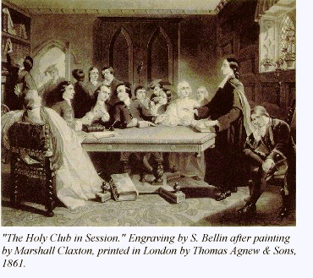
Notes:
23
It was during his years of study at Oxford Univ. that Samuel is credited with founding the “Holy Club,” which John eventually joined and then took over leadership. This group became known as the Methodists because of the method of study.

Slide 24
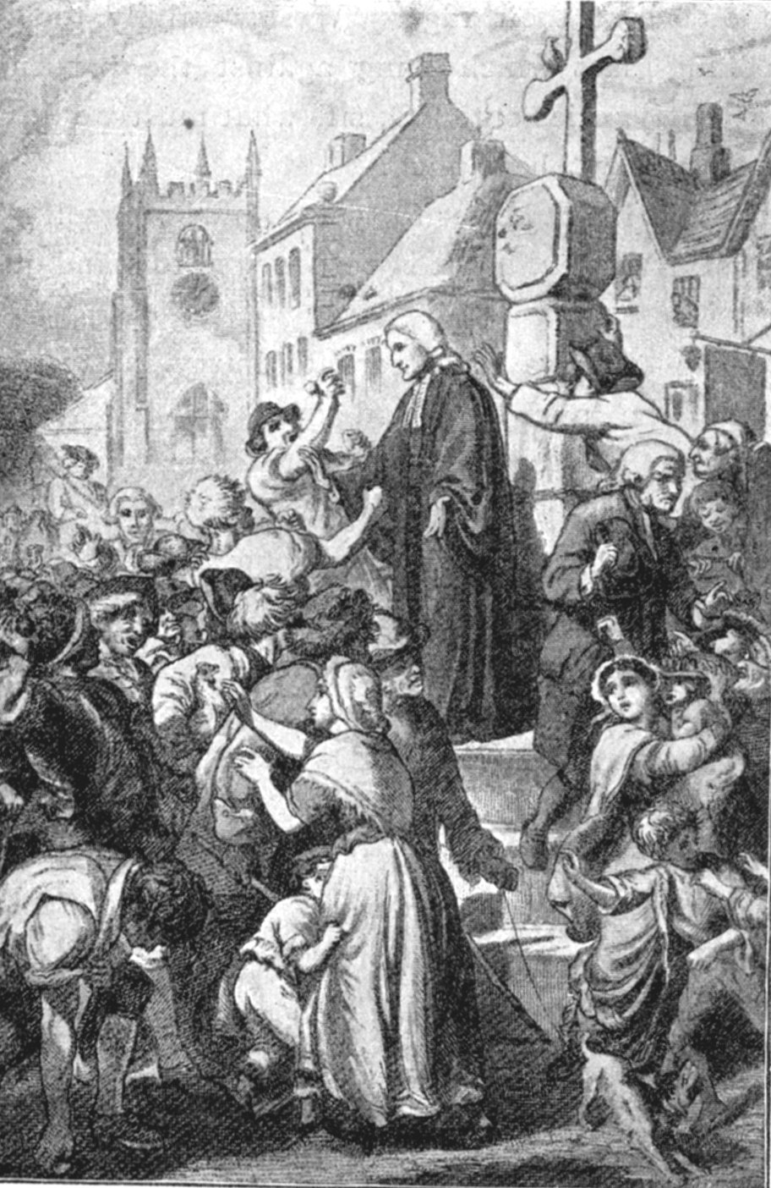
The Preacher
By 1791“Methodism” had nearly 75,000 members & Wesley had averaged 4,000 miles annually on horseback, and preached more than 40,000 sermons!
Notes:
24
His brother Charles had a similar heartwarming experience, and the Methodist ministry was transformed as the evangelical message of God’s forgiving grace was proclaimed..

Slide 25
Exhorters and Class Leaders
Leaders of the Class or Band Meetings
Led prayer, addressed people on the subject of religion, gave encouragement and admonition
Described own experience and testified to their present joy
Did not “take a text”
Notes:
25
Exhorters often became the preachers when the circuit rider or pastor failed to show up.

Slide 26
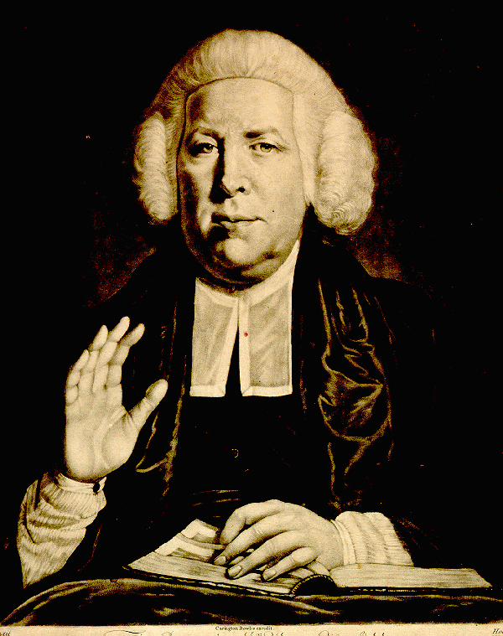
Thomas Maxfield
Exhorter to Lay Preacher
Notes:
26
Appointed a band leader at the Foundry, Thomas Maxfield went from exhorter to lay preacher. He started preaching or “taking a text” in the absence of John Wesley. When John Wesley found out, he was not happy – he spoke with his mother, who replied ”take care what you do with respect to that young man; for he is as surely called of God to preach as you are. Examine what have been the points of his preaching and hear him yourself.”
Wesley did hear Maxfield preach and was satisfied “It is the Lord!” he exclaimed. “Let him do what seemeth him good. What am I that I should withstand God?”

Slide 27
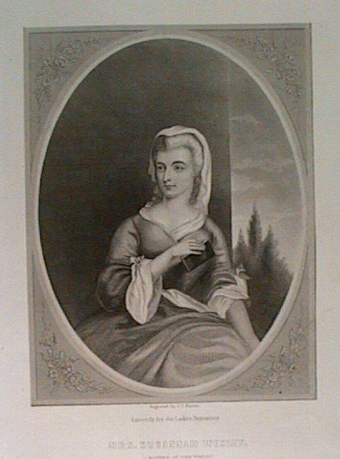
Susannah Wesley
Sarah Crosby
Mary Bosanquet
Notes:
27
Susannah Wesley herself had alarmed her husband by the “irregularity” of her fireside services. Her meetings were Bible studies and training sessions held in the rectory of Epworth.
Sarah Crosby was a woman who was appointed a class leader and became one of the first female preachers in Methodism. The concept of female preaching was highly controversial in the 18th century, so it was a major step for John Wesley to acknowledge the validity of a woman’s call to preach. He did encourage Crosby to speak publicly about her faith, but cautioned her against speaking from a biblical text. “Never speak in a continued discourse—intermix short exhortations with prayer. Keep as far from what is called preaching as you can.” Wesley also gave permission to Mary Bosanquet to preach on account of her “extraordinary call.”

Slide 28
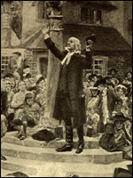
A Hundred Helpers
“Give me one hundred preachers who fear nothing but God, and I care not a straw whether they be clergymen or laymen, such alone will shake the gates of hell and set up the kingdom of heaven on earth.”
John Wesley
Notes:
28
John Wesley was forced to admit that laymen could do a more than an acceptable job of preaching, teaching, and ministry.

Slide 29
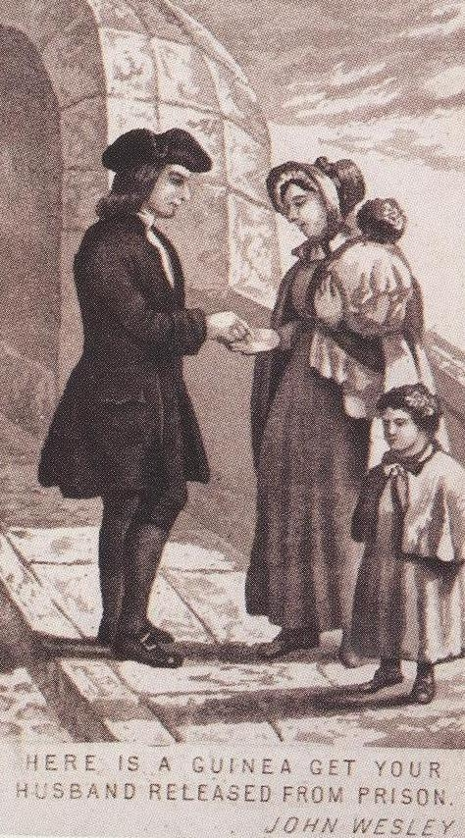
Wesley and the Poor
“Here is a guinea. Get your husband released from prison.”
John Wesley
Notes:
Since the days of John Wesley, we have strived to help the worker, the sick, the poor, the orphaned, the aging, the impaired, the oppressed, and the imprisoned.
Today we need to remember our heritage and restore the ministry of the laity to become the church as God intended it to be.

Slide 30
SMALL GROUPS
What does it mean to you to be a member of Christ’s royal priesthood?
How do you experience the priesthood of all believers?
What mighty acts of God could you proclaim?

Slide 31
Where Does Ministry Happen?
It happens in our daily activity
It happens through new initiatives
It happens through groups and institutions
It happens through the church…through you and through me

Slide 32
Closing Prayer
Teach me to do what pleases you,
because you are my God.
Guide me by your good spirit
into good land.
Amen.
Psalm 143:10 (CEB)

Slide 33
LAY SERVANTS SERVE BY
LEADING

Slide 34
WORSHIP
Notes:
Read Scripture: John 13:12-17
Sing: “Make Me a Servant” (TFWS #2176)

Slide 35
Reading
My God, I lift my face toward you now like a hungry child asking to be fed. My soul is starved; my flesh yearns for the touch that only you can give. Come to me, O God, stay with me; I abandon myself into your hands. Do with me as you will, and whatever you do with me, I thank you. I am prepared for anything; I will accept everything as long as your will is accomplished in the totality of my living.
(Norman Shawchuck, A Guide to Prayer for All Who Seek God [Nashville: Upper Room Books, 2003, 342.])

Slide 36
(Reading)
My God, I give myself to you, placing myself in your hands as a gift of love. It is necessary for me to give myself to you in confidence and without reserve because I love you, and I know you love me also.
Reach down inside me now, O God, and change the gears that race and roar. In place of turmoil give me peace; in place of frenzy give me patience. Then shall I be more like Jesus, who taught us to make room for you in our hectic days.
(Norman Shawchuck, A Guide to Prayer for All Who Seek God [Nashville: Upper Room Books, 2003], 342.)

Slide 37
(Reading)
Teach me, God, to make room for you in all the events and affairs of my days. Then I shall find rest. Then I will be at peace with myself and with you.
(Norman Shawchuck, A Guide to Prayer for All Who Seek God [Nashville: Upper Room Books, 2003], 342.)

Slide 38
Prayer For a New Heart
Thou who art over us,
Thou who art one of us,
Thou who art.
Give me a pure heart, that I may see thee;
a humble heart, that I may hear thee;
a heart of love, that I may serve thee;
a heart of faith, that I may abide in thee. Amen.
(Dag HammerskjÖld, Markings©1964 Alfred A. Knopf, Inc. and Faber & Faber, Ltd.—The United Methodist Hymnal, #392)

Slide 39
SESSION 2: Learning Outcome Goals
Be able to
1. describe servant leadership
2. discuss the important roles in leadership
3. describe and discuss what it means to be a spiritual leader
4. demonstrate the principles of Christian conferencing and describe aspects of consensus and discernment

Slide 40
SERVANT LEADERSHIP
“…Whoever wants to be first among you will be your slave.”—Matthew 20:26b (CEB)
Notes:
40
All Christians who are called to leadership are called to servanthood. The Book of Discipline states in paragraphs 131 and 132 that the ministry of all Christians is one of service for the mission of God in the world.

Slide 41
“After he washed the disciples’ feet, he put on robes and returned to his place at the table. He said to them, “Do you know what I’ve done for you? You call me ‘Teacher’ and ‘Lord,’ and you speak correctly because I am. If I, your Lord and Teacher, have washed your feet, you too must wash each other’s feet. I have given you an example: just as I have done, you also must do. I assure you, servants aren’t greater than their master, nor are those who are sent greater than the one who sent them.”—John 13:12-17 (CEB)
Notes:
The teachings of Jesus on servant ministry and leadership shape this ministry.

Slide 42
SERVANT LEADERSHIP
The ministry of all Christians is one of service for the mission of God in the world.
Notes:
The ministry of all Christians is one of service for the mission of God in the world. It is both a privilege and an obligation. It is a privilege through our spiritual relationship with God to be part of a holy priesthood, and it is an obligation because of that relationship to form new Christian disciples and to guide them in their witness.

Slide 43
(SERVANT LEADERSHIP)
JOHN WESLEY-
“Moving Toward Perfection”
A heart “habitually filled with the love of God and neighbor” and
“having the mind of Christ and walking as he walked”
Notes:
John Wesley not only taught what servant leadership was, but he exemplified it in his own life.

Slide 44
SPIRITUAL LEADERSHIP
Spiritual Disciplines
-Called to Holy Living
-Practice of the Means of Grace
Accountable Discipleship
Unity of Ministry
Notes:
Spiritual leadership requires the practice of spiritual disciplines, the practice of accountable discipleship, and the practice of unity in ministry. These practices are all evidence of spiritual leadership, of leaders who live by the General Rules as found in paragraph 104 in The Book of Discipline…

Slide 45
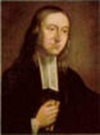
The General Rules…
“It is therefore expected of all who continue therein that they should continue to evidence their desire for salvation
First: By doing no harm, by avoiding evil of every kind…
Notes:
To Wesley, these were not rules of religion but the way of discipleship.

Slide 46
(The General Rules)
Secondly: By doing good; by being in every kind merciful after their power; as they have opportunity, doing good of every possible sort, and as far as possible to all…
Thirdly: By attending upon all the ordinances of God…
(The Book of Discipline ¶104)
Notes:
The ordinances of God are the means of grace: Prayer
Bible Study
Worship
Lord’s Supper
Fasting or Abstinence
Christian Conferencing
Acts of Mercy and Justice

Slide 47
Spiritual Leaders are called to holy living
Patient
Kind
Does not envy
Never boastful
Not conceited
Not Rude
1 Corinthians 13:4-7 (CEB)
Never selfish
Does not gloat
Slow to take offense
Doesn’t keep score
Delights in the truth

Slide 48
Spiritual leadership is...
SERVICE FOR CHRIST
NOT FOR ONE’S EGO!

Slide 49
Spiritual Leaders practice the means of grace
Worship
Prayer
Searching the Scriptures
Lord’s Supper
Fasting or Abstinence
Christian Conferencing
Works of Mercy

Slide 50
Unity of Ministry
We are sent by Christ to live and work together.
Notes:
Para 129 discusses The Unity of Ministry in Christ. It says, “There is but one ministry in Christ, but there are diverse gifts and evidences of God’s grace in the body of Christ” ( Ephesians 4:4-16). The ministry of ALL Christians is complementary. No ministry is subservient to another. All United Methodists are summoned and sent by Christ to live and work together in mutual interdependence and to be guided bit the Spirit into the truth that frees and the love that reconciles.
All roles are important in the church and none is subservient to another.
Laity and clergy, bishops and lay leaders, preachers and lay servants are all partners in ministry.

Slide 51
Unity of Ministry?
LET’S TALK ABOUT MEETINGS!

Slide 52
“He gave some apostles, some prophets, some evangelists, and some pastors and teachers. His purpose was to equip God’s people for the work of serving and building up the body of Christ until we all reach the unity of faith and knowledge of God’s Son. God’s goal is for us to become mature adults—to be fully grown, measured by the standard of the fullness of Christ.”—Ephesians 4:11-13 (CEB)
Notes:
Applies to everyone in the congregation/ community – not just pastors.
New forms of ministry call for the clergy and laity to work together in new ways.
As lay leader or lay member you have the responsibility to work with your pastor to guide the congregation through change.
Many clergy – not all – encourage and support the ministry of the laity.

Slide 53
CHRISTIAN CONFERENCING
Personal concerns
Prayer and discernment
Practice inclusiveness
Clear communication guidelines
Clear agenda
Respectful of time
Notes:
Christian conferencing has some significant components…

Slide 54
DISCERNMENT
Look for God’s guidance
Listen for God’s call
“To see to the heart of the matter with spiritual eyes”
Notes:
Discernment is not a new concept! Samuel listened to God’s voice to discern which of Jesse’s sons would be anointed king.
Solomon requested a wise and discerning mind. Romans 12:2 says, Be transformed by the renewing of your mind so that you may discern what is the will of God – what is good and acceptable and perfect.
One of the spiritual gifts is listed in I Cor. 12:10 as the discernment between spirits. John 4:1 says, Do not believe every spirit, but test (discern) the spirits to see whether they are from God.
Early Christians feared the voices of false prophets, so they tested the spirits. It was the spirit of God present that determined what served the common good of the community.
Remember the circumcision argument in Acts? Whether new converts needed to be circumcised? – The apostles and elders met to consider the question, and they came to one mind and heart through discernment (Acts 15).
The purpose and goal of spiritual discernment is knowing and doing God’s will.
We must keep our eyes and our hearts on that purpose and goal.
Why with this long history of the use of discernment do we ignore it in our church decision making today?
Quakers still use it. They form what they call Clearness Committees who meet with a person on how to proceed with a decision or dilemma.

Slide 55
CONSENSUS
A general agreement among a group of people
The people work together for the best possible decision for the group

Slide 56
Consensus
Creates cooperative dynamic
Work together for best possible decision for the group
Parliamentary Procedure
Creates competitive dynamic
Ideas owned and defended
Notes:
Other churches have concluded that consensus is a better format for making decisions.- Quakers, Uniting Church of Australia
The practice of holy conferencing is the manner in which we govern our life together
It can profoundly affect our church because it calls us to build one another up – not tear down others.
It emphasizes fellowship within the Body of Christ.
In Parliamentary procedure we employ motions and amendments and amendments of amendments; there is voting and a division of the house – it produces a win/lose situation. If the presider is not an expert with the procedures, mass confusion can result.
It is just as acceptable to attack and diminish another’s point of view as it is to promote and endorse your own ideas.
Voting can happen without a clear picture of the issue due to the adversarial environment.

Slide 57
PRACTICING CONSENSUS
A leader in a church feels that a new ministry should be started in the community. It will require funding and support from the congregation. Should the church support it?
The choir needs new robes! The current ones are shabby and there are not enough of the right sizes. Should the church buy new ones or try to find some that another church has for sale?
A problem has been noted with the conduct of a person in leadership. How should the person be approached about his/her behavior?
Notes:
Use this time to do an exercise in consensus. Divide into small groups of four to six persons and give them one of the situations listed here. Ask them to come to a consensus on a solution using the process in their participant’s book on page 41.

Slide 58
MEETINGS THAT MATTER
- Worship together - Celebrate - What needs to be done? - Challenges - Send forth - Give God thanks!

Slide 59
SMALL GROUPS
Who has served as an example of a servant leader for you?
How did this person exhibit servant leadership?
How can you serve and lead at the same time?
Why is servant leadership important?
Notes:
Discuss biblical reflection questions at the end of Session 2 (pg. 42) in the participant’s book using their assignment to observe leadership styles of leaders they have experienced.

Slide 60
Closing Prayer
Lord, teach me what your statutes are about, and I will guard every part of them.
Help me to understand so I can guard your instruction and keep it with all my heart.
Amen.
Psalm 119:33-34 (CEB)

Slide 61
LAY SERVANTS SERVE
BY
CARING

Slide 62
WORSHIP
Notes:
Read Scripture: Matthew 25:35-37, 40
Sing: “Make Me a Servant” (UMH #389)

Slide 63
Privileges
We shower daily, while others bathe in dirty rivers occasionally.
We eat three meals a day, plus unneeded snacks,
while others starve.
We sleep warm and soundly while others never rest.
We have closets filled with unworn clothing
while others wear all they have each day.
(Pete Hammond, Lessons, Prayers & Scriptures on the Faith Journey, [Intervarsity/USA Marketplace], 109.)

Slide 64
(Privileges)
We have extended families, while others live alone.
We own homes, sometimes more than one, while others are homeless.
We enjoy safety, while others live with death, war, and violence daily.
We work or change jobs, while others beg for minimal survival.
We travel extensively and freely, while others live their whole lives where they were born.
(Pete Hammond, Lessons, Prayers & Scriptures on the Faith Journey, [Intervarsity/USA Marketplace], 109.)

Slide 65
(Privileges)
We attend schools and continuing education,
while others suffer illiteracy.
We make and protect retirement plans,
while others die far too early in poverty.
We have extensive medical systems,
while others have no health care and die early.
Unlike millions around the world, we North Americans are inordinately blessed, tempted to assume our rights to these gifts, even to fighting for them, and frequently misusing these privileges which are on loan from God.
(Pete Hammond, Lessons, Prayers & Scriptures on the Faith Journey, [Intervarsity/USA Marketplace], 109.)

Slide 66
Prayer
Lord, forgive my possessive and selfish nature. Help my attempts at becoming a good steward of all the opportunities and gifts that you provide.
Help me to remember and reach out to those without daily bread or the Good News of salvation! Please make me generous like you. Amen.
(Adapted from Pete Hammond, Lessons, Prayers & Scriptures on the Faith Journey [Intervarsity/USA Marketplace], 109.)

Slide 67
SESSION 3: Learning Outcome Goals
Be able to
1. discuss the biblical basis for caring ministry
2. compare and contrast acts of compassion and acts of justice
3. discuss several types of caring ministries
4. discuss ways to show care for creation

Slide 68
CARING
“For I was hungry and you gave me food to eat. I was thirsty and you gave me a drink. I was a stranger and you welcomed me. I was naked and you gave me clothes to wear. I was sick and you took care of me. I was in prison and you visited me.”—Matthew 25:35-36 (CEB)

Slide 69
WORKS OF MERCY Acts of Compassion…Acts of Justice
Notes:
69
Acts of compassion are those things we do to meet the needs of our neighbor who is anyone we encounter who is in need. Acts of justice are related because that is when we ask the questions, “Why” and “What?” Why is our neighbor suffering? What is the cause?
These are more than random acts of kindness; they are intentional acts that show Christ’s love to a hurting world!
Acts of compassion are anything one does to demonstrate God’s love by caring for creation and neighbor. Acts of compassion show our care for others by actually doing something.
Acts of justice are the public extension of our acts of compassion. To do justice is to love God and the world, especially those who are poor, hungry, abused and vulnerable. To witness to Jesus Christ in the world through acts of justice is to serve those whom Christ came to serve. Another act of justice is to examine our own attitudes toward the poor, the prisoner, the victim.
List acts of compassion and justice that the class has performed. Discuss the differences between them.

Slide 70
“Isn’t this the fast I choose: releasing wicked restraints, untying the ropes of a yoke, setting free the mistreated, and breaking every yoke?
Isn’t it sharing your bread with the hungry and bringing the homeless poor into your house, covering the naked when you see them and not hiding from your own family?”—Isaiah 58:6-7 (CEB)
Notes:
70
Isaiah made it plain -- piety that ignores the needs of the poor would get nowhere with God.
You might be devout, fast and pray, wear sackcloth and cover yourself with ashes, but if you allow injustice and pursue your own selfish interests and disregard the needs of the disenfranchised – all of your outward faith will mean nothing. Jesus also questions who was a neighbor to the man who was attacked and left by the roadside in Luke 10: 29-37.
And in Matthew 25: 31-46, we find out what happens to those who ignore the needs of the hungry, thirsty, sick and imprisoned.

Slide 71
Types of Caring Ministries
PRAYER MINISTRY
PRISON MINISTRY
(KAIROS)
STEPHEN MINISTRY
Others?

Slide 72
Prayer Ministry
Active
Intercessory
Caring
Compassionate
Loving
Notes:
Prayer is an action; it is doing something. Look to see where God is at work, and join God in that work. Even though we feel bad because we can’t always “do” something in the terms of accomplishing a task, sometimes praying is exactly what we need to be doing. Prayer is powerful as long as prayer is active, intercessory, caring, compassionate, and loving.

Slide 73
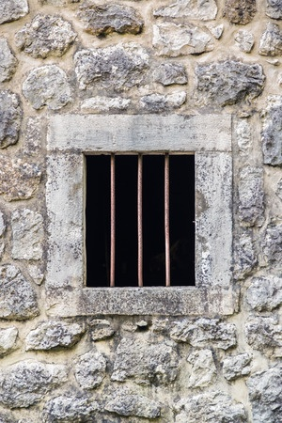
Prison Ministry KAIROS
“In the love of Christ, who came to save those who are lost and vulnerable, we urge the creation of genuinely new systems for the care and support of the victims of crime and for rehabilitation that will restore, preserve, and nurture the humanity of the imprisoned.”
(Social Principles, 68.F)
Notes:
In 1996, General Conference added to the Social Principles a statement regarding restorative justice ministries that states, “In the love of Christ, who came to save those who are lost and vulnerable, we urge the creation of genuinely new systems for the care and support of the victims of crime and for rehabilitation that will restore, preserve, and nurture the humanity of the imprisoned.” -(Social Principles, 68.F)
Kairos is an organization of ministries that addresses the spiritual needs of incarcerated men, women, and children, their families, and those who work in the prison environment in order to bring Christ’s love and forgiveness and to assist in the transition toward becoming productive citizens. Kairos came out of the Cursillo movement and the Walk to Emmaus.

Slide 74
Stephen Ministry
“Carry each other’s burdens and so you will fulfill the law of Christ.”—Galatians 6:2 (CEB)
Notes:
74
Stephen Ministry is the one-to-one lay caring ministry that takes place in congregations that use the Stephen Series system.
Stephen Ministry congregations equip and empower lay caregivers—called Stephen Ministers—to provide high-quality, confidential, Christ-centered care to people who are hurting.
Stephen Ministry began in 1975 and is now in more than 12,000 congregations, and more than 600,000 people have trained as Stephen Ministers (laypeople who provide care to those who are hurting) in their congregations.

Slide 75
Caring Ministries
Racial/Ethnic/Cultural Cares
Practice inclusiveness
Accept those who are different
Understand that God created diversity
Listening
The Ministry of Presence
Caring Responses

Slide 76
CARING
Discuss types of caring ministries in your church.
Identify ways individuals or congregations can do more to reach out into the community.

Slide 77
Stewardship of Creation
“The Lord God took the human and settled him in the garden of Eden to farm it and to take care of it.”—Genesis 2:15 (CEB) “We do not inherit the Earth from our ancestors; we borrow it from our children” (Native American Proverb)
Notes:
77
List ways we can be good stewards of the earth and other gifts God has given.
Discuss making a commitment to practice care of creation.
What can we do in our wasteful culture to help improve our environment and the world’s natural resources?

Slide 78
SMALL GROUPS
In what ways do you evidence belief in Jesus Christ by caring for the hungry, thirsty, strangers, et al.? What opportunities have you experienced and neglected to act upon to care for your neighbor? In what specific ways can you as a Lay Servant improve your caring responses to your neighbor?
Notes:
Discuss biblical reflection questions at the end of Session 3 (pg. 52) in the participant’s book.

Slide 79
Closing Prayer
For the beauty of the earth,
For the glory of the skies,
For the love which from our birth
over and around us lies;
Lord of all, to thee we raise
this our hymn of grateful praise. Amen.
Amen.
Public Domain, “For The Beauty of the Earth”, UMH #92
Notes:
May be sung.

Slide 80
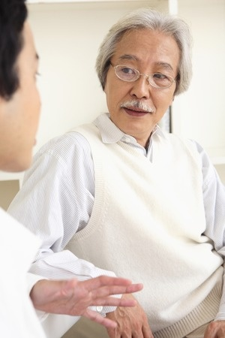
LAY SERVANTS SERVE
BY
COMMUNICATING

Slide 81
WORSHIP
Notes:
Read Scripture: Romans 10:14-15, 17
Sing: “To God be the Glory,” verses 1 and 2 (UMH #98)

Slide 82
The Nicene Creed
We believe in one God, the Father, the Almighty, maker of heaven and earth, of all that is, seen and unseen.
We believe in one Lord, Jesus Christ, the only Son of God, eternally begotten of the Father, God from God, Light from Light, true God from true God, begotten, not made, of one Being with the Father; through him all things were made.
For us and for our salvation he came down from heaven, was incarnate of the Holy Spirit and the Virgin Mary and became truly human. For our sake he was crucified under Pontius Pilate; he suffered death and was buried.
(UMH #880)

Slide 83
(The Nicene Creed)
On the third day he rose again in accordance with the scriptures; he ascended into heaven and is seated at the right hand of the Father. He will come again in glory to judge
the living and the dead, and his kingdom will have no end.
We believe in the Holy Spirit, the Lord, the giver of life, who proceeds from the Father and the Son, who with the Father and the Son is worshipped and glorified, who has spoken through
the prophets. We believe in one holy catholic and apostolic church. We acknowledge one baptism for the forgiveness of sins. We look for the resurrection of the dead,
and the life of the world to come. Amen.
(UMH #880)

Slide 84
Prayer For God’s Reign
We believe in you, O God, for you have made the suffering of humanity your suffering. You have come to establish a kingdom of the poor and humble. Today we sing to you, because you are alive, you have saved us, you have made us free. Amen.
(Cuba, 20th Cent. The United Methodist Book of Worship, #511).

Slide 85
SESSION 4: Learning Outcome Goals
Be able to
1. discuss the importance of communication skills in various settings
2. list respectful communication guidelines
3. describe the process of mutual invitation
4. demonstrate listening skills
5. share faith stories with another participant

Slide 86
“So how can they call on someone they don’t have faith in? And how can they have faith in someone they haven’t heard of? And how can they hear without a preacher? And how can they preach unless they are sent? As it is written, ‘How beautiful are the feet of those who announce the good news.’ ”
So faith comes from listening, but it’s listening by means of Christ’s message.
Romans 10:14-15,17 (CEB)
Notes:
We are called to share the Good News:
- It is not standing on the street corner shouting Bible verses!
- It is sharing from your heart, your faith story with those with whom you have a relationship!

Slide 87
Respectful Communications Guidelines
R = take Responsibility for what you say and feel, without blaming others. E = Empathetic listening. Try to understand how the other person feels. S = be Sensitive to differences in communication styles. P = Ponder on what you hear and feel before you speak. E = Examine your own assumptions and perceptions. C = keep Confidential what others have to say. T = Tolerate what others have to say.
(©Eric Law. Used by permission.)
Notes:
How can you work to ensure respect at meetings?

Slide 88
MUTUAL INVITATION
Notes:
Have the group break into groups of four to six and practice the process of mutual invitation. Refer to pages 60-61 in the participant’s book.

Slide 89
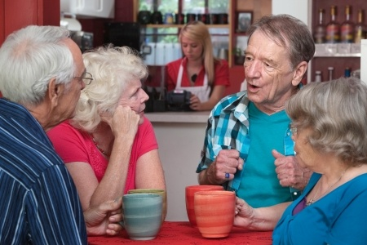
Communication Settings
Person-to-person
Personal Space
Mutual Understanding
Social media
Facebook
Twitter
e-mail

Slide 90
Special Situations
Non-native Language
Other Age Groups
People with Mental Health Issues
People with Intellectual Disabilities

Slide 91
Communication – Active Listening
Pay attention
Show that you are listening
Provide feedback
Defer judgement
Respond appropriately
Notes:
Have the group discuss listening skills from pages 61-63 in the participant’s book.
List on the flip chart what constitutes a “good” listener and a “poor” listener. Remind them
that they will have the opportunity to practice the “good” listening skills as they listen to their partner’s faith story.

Slide 92
Communication - Speaking
Practice speech patterns and pronunciations
Gestures and Body Language
Eye Contact
Humor (be careful!)
Cultural Consideration and Context
Notes:
Share information about avoiding sarcasm and ethnic “humor” that rarely is humorous.

Slide 93
(Communication – Speaking)
Listen to the text
Study the text & context
Don’t avoid the uncomfortable
Explore transformation
Translate from then to now
Trust the text

Slide 94
(Communication – Speaking)
Use the 3 p’s:
Preparation
Practice
Prayer

Slide 95
Communication - Speaking to Large Groups
Give information in small sections
Step-by-step in logical order
Be creative
Use examples
Use a variety of styles of presentation

Slide 96
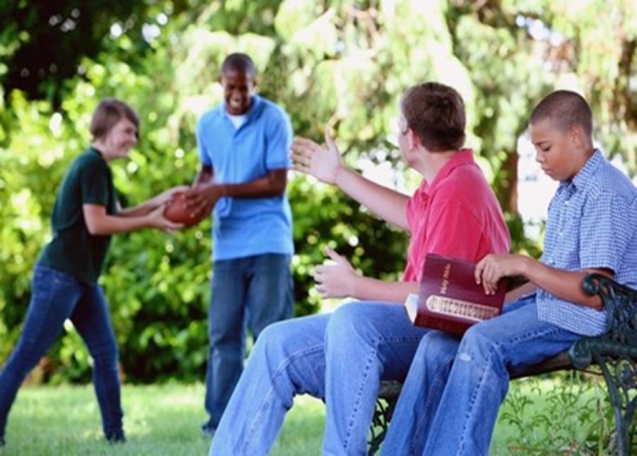
Ways to Make a Difference
A Ministry of Competence
A Ministry of Caring
A Ministry of Ethics
A Ministry of Change

Slide 97
Sharing Your Faith Story
Notes:
Have the group divide into pairs and share their faith stories with each other.
Have them evaluate the communication skills and listening skills of each other.
Each person has ten minutes to tell his or her story.
After everyone has shared, spend ten minutes evaluating both the speaker and the listener.
(See Evaluation Questions on page 49 and 51 in the Basic Course Leader’s Guide appendix.)

Slide 98
Journaling
Notes:
Have the group observe quiet time to journal the answers to the questions in the biblical reflection on page 68 of the Basic Course Participant’s Book.
Ask them to list ways they can make a difference in their daily lives at work, home, school, or in the community.

Slide 99
Communication
How will they hear it?
Who will tell them?
If you were to tell them, what would you say or do?
What are some ways that you can share your faith story without preaching or quoting Scripture?

Slide 100
Closing Prayer
Take my life! Lord, put me to doing your work and your will in the world so that the lost and hungry souls may be attracted to your love and mercy and be drawn into the embrace of your love. Amen.
(Rueben Job and Norman Shawchuck, A Guide to Prayer for All Who Seek God [Nashville: Upper Room Books, 2003], 407.)
Notes:
May be sung.

Slide 101
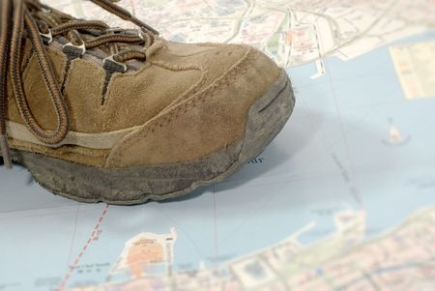
LAY SERVANTS SERVE
BY GOING
INTO THE WORLD

Slide 102
WORSHIP
Notes:
Read Scripture: Matthew 28:16-20
Sing: “Lead Me, Lord” (UMH #473)

Slide 103
God’s Ways Are Not Our Ways
We desire pleasure and freedom from pain.
God invites us to growth and maturity.
We seek escape from difficulty.
God encourages us to engage the world’s brokenness.
We want quick answers to our questions.
God asks us to “Be still and know that I am God.”
We demand solutions to our problems.
God teaches life-long learning amid inconvenience, conflict, and pain.
(Pete Hammond, Lessons, Prayers & Scriptures on the Faith Journey, Intervarsity/USA Marketplace, p 93.)

Slide 104
(God’s Ways Are Not Our Ways)
We want power and recognition.
God calls us to humility.
We want relief from stress.
God gives us hope in harsh realities.
We want safety and security.
God beckons us to sacrificial servanthood.
We want health and comfort.
(Pete Hammond, Lessons, Prayers & Scriptures on the Faith Journey, Intervarsity/USA Marketplace, p 93.)

Slide 105
(God’s Ways Are Not Our Ways)
God offers inner serenity and peace.
We want happiness—now.
God delivers joy all through life.
“My plans aren’t your plans, nor are your ways my ways, says the Lord. Just as the heavens are higher than the earth, so are my ways higher than your ways, and my plans than your plans.”—Isaiah 55:8-9 (CEB).
(Pete Hammond, Lessons, Prayers & Scriptures on the Faith Journey, Intervarsity/USA Marketplace, p 93.)

Slide 106
Prayer
God, you are like a baker. The leaven you provide raises our hopes. You shape our lives with your hands—they are strong yet gentle.
We ask that you warm us in the oven of your love. Form our common lives by your grace so that we may in turn nourish hope in the world. We trust in you. Amen.

Slide 107
SESSION 5: Learning Outcome Goals
Be able to
1. describe roles in fulfilling Great Commission
2. discuss importance of continued study and spiritual growth in the life of Christian leaders
3. discover important role of hospitality in the church
4. describe Appreciative Inquiry and Asset-Based Community Development and discuss ways these tools can be used to spread the gospel

Slide 108
The Great Commission
“Now the eleven disciples went to Galilee, to the mountain where Jesus told them to go. When they saw him, they worshipped him, but some doubted. Jesus came near and spoke to them. “I’ve received all authority in heaven and on earth. Therefore, go and make disciples of all nations, baptizing them in the name of the Father, and of the Son and of the Holy Spirit, teaching them to obey everything that I’ve commanded you. Look, I myself will be with you every day until the end of this present age.”
—Matthew 28:16-20 (CEB)

Slide 109
Forms of Ministry
Lay Servant
Lay Speaker
Lay Minister
Deaconess/Home Missioner
Specialized Ministry
Missionary
Local Pastor
Deacon
Elder
Notes:
The United Methodist Church has myriad of forms of ministry that equip and empower people. One additional path is that of the lay missioner, but through a new collaboration between the National Plan for Hispanic/Latino Ministries, the General Board of Higher Education and Ministry, and Discipleship Ministries, the lay missioner will be integrated into the Certified Lay Ministry program.
All forms of ministry are of kingdom value! God has called us ALL to ministry. God may be calling you into ministry as a layperson, or may be calling you into ministry as a clergyperson. The important thing is that we respond to that call. The gifts assessment is one of those tools that can help us determine where our gifts fit best.
Lay Servant Ministries is an excellent way to deepen our discipleship and to explore that call to ministry.
As we learned earlier, the clergy have the responsibility to equip and empower the saints for ministry. We are the saints. One of the best lay leadership development tools The United Methodist Church has is Lay Servant Ministries. Through this inroad to ministry, laypersons learn and practice leadership through service in the local church and/or beyond has they participate in study, in caring for the congregation, in communicating and in leading through various means in the congregational ministry of the church in the community.

Slide 110
Lay Servants
Serve local church and/or beyond
Give leadership, assistance, and support
Lead meetings
Conduct or assist in services of worship
Present sermons and addresses
Provide leadership for congregational and community life
Foster care-giving relationships
Assist in Holy Communion
Notes:
Lay Servants have many avenues of ministry in the local church.
They serve in the local church by vital leadership, care-giving ministry and witness of the spoken word.
They give leadership, assistance, and support to the mission and ministry of the church.
They lead meetings for prayer, training study, and discussion as requested.
They conduct or assist in services of worship and present sermons and addresses when requested.
They assist in the distribution of the elements for Holy Communion.
To become a certified lay servant as a professing member of The United Methodist Church, you just need to complete this BASIC course and an advanced course of your choosing. After you receive the approval of your pastor and church council or charge conference, the district committee on Lay Servant Ministries will review your qualifications and provide the certification. To become a lay speaker, you must first become a lay servant. The lay speaker track is for those who feel called specifically to pulpit supply ministry. There are further requirements for this track, which you can learn more about from your lay servant ministries district or conference leadership.

Slide 111
Going into the World
Lay Servants are
Ready to serve
Informed
Committed
Equipped
Notes:
Lay Servants are People who are;
Ready and desirous to serve the church
Well informed on and committed to the Scriptures and the doctrine, heritage, organization, and life of the U.M. Church
Willing to receive specific training to develop skills in witnessing to the Christian faith through spoken communication, church and community leadership, and care-giving ministries

Slide 112
Certified Lay Servants
Serve in their local church and/or beyond, and may be asked to serve on their district and conference committees
May serve local churches other than the one where they hold membership

Slide 113
The Role of Lay Speaker
Notes:
During GC 2012 – the original proposal for the name change was amended to include a role of a lay speaker who feels specifically called to pulpit supply and whose function is to preach in the absence of a pastor. While a pastor may invite anyone to preach, these persons are on record within the district as persons who are equipped for this specific purpose.
Courses:
Discovering Your Spiritual Gifts
Leading Prayer
Leading Worship
United Methodist Heritage (Living Our UM Beliefs)
United Methodist Polity ( Life Together in the United Methodist Connection)
Preaching
In addition, Lay speaker candidates are interviewed by the District Committee on LSM and recommended to the annual conference LSM comm.

Slide 114
Certified Lay Minister
Notes:
The Certified Lay Ministers are called to preach the word, provide a care ministry to the congregation, assist in program leadership, and are a witness in the community for the growth, missional and connectional thrust of The United Methodist Church as a part of a ministry team under the supervision and support of a clergyperson. Certified Lay Ministers might be church administrators, lay missionaries/church planters, lay missioners, parish nurses, congregational care ministers, visitation ministers, or engaged in some other type of ministry -- much like class leaders of Wesley’s day or the tent-making ministry of Paul in the New Testament. CLMs complete a more strenuous track of study to further equip them for more in-depth ministry, are evaluated and recommended by the district committee on ministry for certification, and are assigned by the district superintendent.

Slide 115
We are called!
Notes:
We are called to participate in God’s mission to the world. These are some of the ways to become equipped for this mission. Practice the spiritual disciplines so that you are spiritually grounded. Improve your skills – re-assess your giftedness. Work in areas for which you have a passion. But most of all, spend time with God – listening for God’s will in all you do.

Slide 116
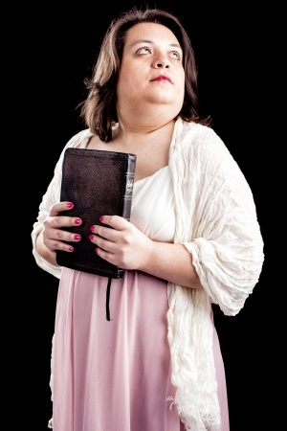
Continuous Study and Spiritual Growth Disciple: One who reflects Jesus
“Discipleship is not a question of our own doing; it is a matter of making room for God so that he can live in us.”—J.H. Arnold
Notes:
116
We are called by God, and it is so important for us to continue studying and growing spiritually as disciples. None of us have arrived – we are going on to perfection.

Slide 117
ONGOING OUTREACH: Hospitality
What are some ways you can practice hospitality at church or during a meeting this week?
What are some ways you can practice hospitality outside the church in your community and workplace?
What difference does hospitality make – to others and to you?
Notes:
If we are the body of Christ in the world, why aren’t we reaching out to the least and the lost? Why are we so inwardly focused on our church members and church buildings? God has called us! We have a wonderful opportunity to participate in God’s mission to the world, and that goes beyond our church walls. Not only are we to practice hospitality inside the church building, but we are also to practice hospitality in the community as an outreach. How are we creating a sense of belonging among the least and the lost in the community outside our church walls? How can you or your congregation be the presence of Christ in the community outside the doors?

Slide 118
APPRECIATIVE INQUIRY
Problem Solving _______ Appreciative Inquiry
Describe Problem Discover Capacity
Diagnose Causes Dream the Possible
Designate Fix Design the Best
Develop Plan Deliver the New Way
Basic Assumptions: You are lacking, defective, and needy (Human “sin”).
If you work harder on your deficits,
you will get better.
Basic Assumptions: You already have abundantly more than you know (God’s gifts). If you build on your strengths, you release energy to grow healthy.
Notes:
Discuss how looking at assets and positive experiences rather than focusing on a lack of resources or negative experiences could change the way we plan and evaluate ministries.
How might the outlook regarding our opportunities change?

Slide 119
Asset-Based Community Development: How We Work with Other Partners
Assumptions of ABCD (from Green & Moore, ABCD Training Group):
Everyone has gifts.
One-on-one relationships are the key.
Real leaders have followers.
Institutions lead best by serving citizens.
Everyone really does care.
People, associations, and institutions act on what they care about.
Notes:
119
Discuss organizations in the communities that might become partners in mission and ministry. How could our mission and ministry expand if we join resources with other churches or
community organizations?
How can we work together to care for God’s people and promote the kingdom of God on earth?

Slide 120
SMALL GROUPS
How do you see your role in making disciples?
In what ways can you use your gifts to fulfill this Great Commission?
What preparation do you need to follow this commandment?
Notes:
Review questions from the biblical reflection on page 78 of the Basic Course Participant’s Book.

Slide 121
The 2012 Book of Discipline, ¶266-271
1. Be a professing and active member of a local church/charge
2. Make application in writing to appropriate committee and obtain recommendation from pastor and church council or charge conference
3. Complete the BASIC Course for Lay Servant Ministries (and one advanced course for certification)
4. To be certified, have qualifications reviewed by the District Committee on Lay Servant Ministries and the annual charge conference
5. Submit an annual report along with a reapplication with pastor and church council/charge conference recommendations to charge conference and LSM leadership
6. Complete a refresher (local) or advanced (certified) course every three years
Notes:
Are you ready to dive into your ministry?

Slide 122
CLOSING WORSHIP
Commitment
and
Anointing
Notes:
Read “Centering Prayer:
“Like the sun that is far away and yet close at hand to warm us, so God’s spirit is ever present around us. Come, Creator, into our lives. We live and move and have our very being in you. Open now the windows of our souls. Amen. (from 1987 United Methodist Clergywomen’s Consultation Resource Book, 61)
Sing: “Here I Am, Lord” (UMH #593)

Slide 123
Closing Prayer A Covenant Prayer in the Wesleyan Tradition
I am no longer my own, but thine.
Put me to what thou wilt, rank me with whom thou wilt.
Put me to doing, put me to suffering.
Let me be employed by thee or laid aside for thee,
Exalted for thee, or brought low for thee.
Let me be full, let me be empty.

Slide 124
(Closing Prayer: A Covenant Prayer in the Wesleyan Tradition)
Let me have all things, let me have nothing.
I freely and heartily yield all things to thy pleasure and disposal.
And now, O glorious and blessed God, Father, Son, and Holy Spirit,
Thou art mine and I am thine. So be it.
And the covenant which I have made on earth,
Let it be ratified in heaven. Amen.
Notes:
Share signs of peace.
Close with this blessing:
“God be in your head, and in your understanding.
God be in your eyes, and in your looking.
God be in your mouth, and in your speaking.
God be in your heart, and in your thinking.
God be at your end, and at your departing. Amen.”
(Sarum Liturgy, England, 13th CENT>,ALT., The United Methodist Book of Worship, 566)

Slide 125
THANK YOU
for serving!

Slide 126
Copyright
“Basic Course Lay Servant Ministries” Copyright © 2013 The General Board of Discipleship of The United Methodist Church, PO Box 340003, Nashville TN 37203-0003. Website: http://www.umcdiscipleship.org. This presentation may be reprinted and used for nonprofit local church and educational purposes with the inclusion of the complete copyright citation plus the words "Used by permission." It may not be sold, republished, altered, used for profit, or placed on a website not under the auspices of The General Board of Discipleship.
Notes:
126

